Slide 1
Introduction to Computer Engineering
ECE/CS 252, Fall 2011
Prof. Mikko Lipasti
Department of Electrical and Computer Engineering
University of Wisconsin – Madison

Slide 2
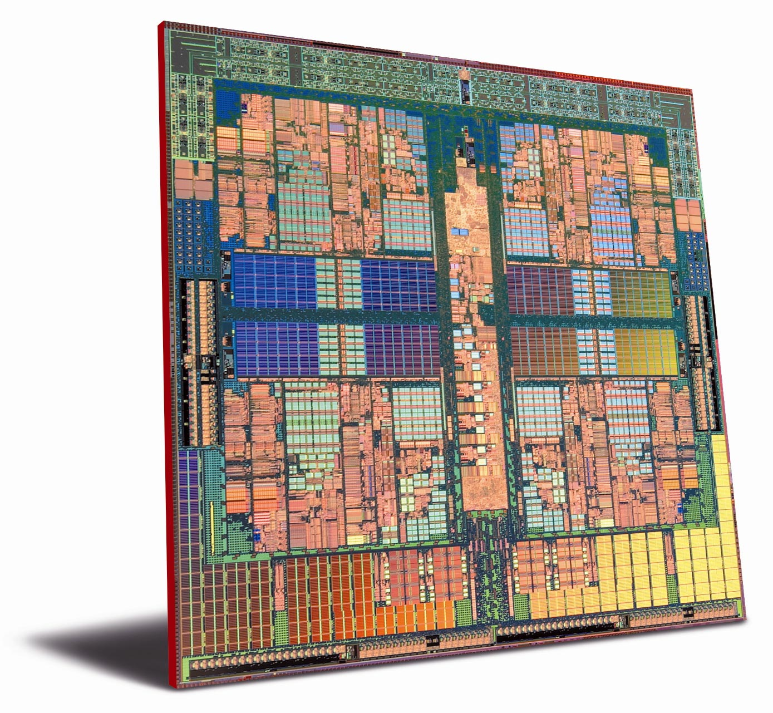
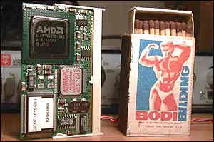
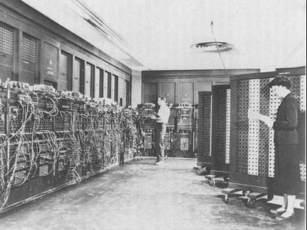
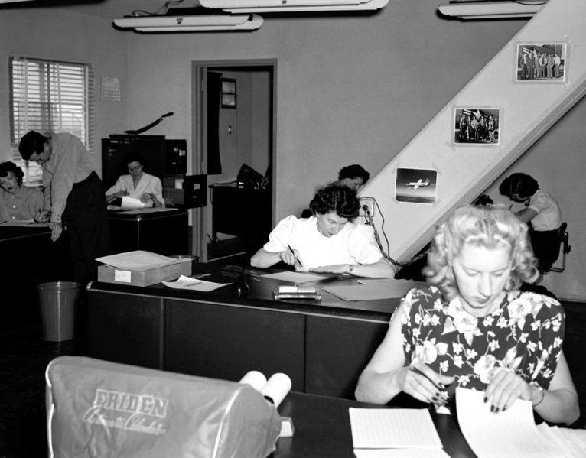
What is a Computer?

Slide 3
Computers!
Engineers and scientists of all disciplines rely on computers for many aspects of their work
Not just word processing, spreadsheets, CAD, etc.
Computational methods, data mining, analysis/synthesis are fundamental to advances in many fields
Many of the advanced techniques used in today’s microprocessors were invented right here at UW
Some of the most renowned computer design researchers in the world are on our faculty
There is a near-100% likelihood that a Wisconsin graduate helped design the computer or processor that you own

Slide 4
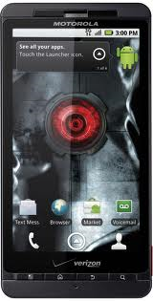
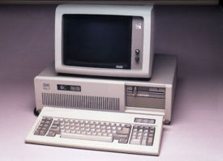
1987 vs. 2010
System | IBM PC/AT | Motorola Droid X
Year | 1987 | 2010
Cost | $2000 | $199 (w/contract)
Form factor | ½ desktop | Pocket
CPU | 12 MHz 80286 | 1GHz TI OMAP
Memory | 512KB | 512MB
Storage | 20MB hard disk, 1.2MB floppy | 8+ GB
Display | 80x25 monochrome text | 480x854 pixel color
Peripherals | Keyboard | Camera, phone, web
Connectivity | 1200 baud dialup modem | 3G, WiFi

Slide 5
$10 base; 60% growth
Year | Salary | Comments
0 | $10 | Base
3 | $40 | Still live at home
16 | $18K | Buy car
21 | $193K | Buy median house in Madison
36 | $223M | Need fundamentally new ways to spend money
51 | $2.5T | Replace US Federal Government

Slide 6
Performance Growth
Unmatched by any other industry !
[John Crawford, Intel]
Doubling every 18 months (1982-1996): 800x
Cars travel at 44,000 mph and get 16,000 mpg
Air travel: LA to NY in 22 seconds (MACH 800)
Wheat yield: 80,000 bushels per acre
Doubling every 24 months (1971-1996): 9,000x
Cars travel at 600,000 mph, get 150,000 mpg
Air travel: LA to NY in 2 seconds (MACH 9,000)
Wheat yield: 900,000 bushels per acre

Slide 7
This Course
This course will:
Help you understand the significance and pervasiveness of computers in today’s society and economy
Teach you how computers really operate and how they are designed
Introduce you to concepts that students in the Computer Engineering and Computer Science degree programs learn in depth over four years
Prepare and motivate you for study in these degree programs (CMPE, EE, CS)
Counts towards GCR introduction to engineering requirement

Slide 8
Course Outline
Prerequisite – none
Major topics in course
Introduction to computers and computing
Information representation and manipulation
Logic elements and combinational Logic
Sequential Logic and Memory
Simple computer organization, design and operation
Machine language and instruction set architecture
Assembly language
Programming constructs

Slide 9
Typical Weekly Structure
Monday lecture Ani Sci 212
Prepare by reading text beforehand
On your own
Watch online lecture + examples
Wed discussion
Individual & team quiz
Review
Fri discussion
Quiz or applied homework
Review, homework help

Slide 10
Web Page & Syllabus
http://ece252.ece.wisc.edu
Instructor & TAs
Textbook
Lecture Notes
Discussion sections
Schedule
LC-3 Simulator
Grading
Exams
Homework

Slide 11
Reminders/Advice
Textbook – read BEFORE corresponding lecture
Online lectures – view before discussion
Quizzes will assume that you have
Homework – completed in groups (not hw1)
Will reinforce in-class coverage
Will help you prepare for midterm exams
Study Groups of ~4
Assigned in your discussion section
Should meet weekly outside of discussion
Review material, complete homework assignments

Slide 12
Technology
Technology advances at astounding rate
19th century: attempts to build mechanical computers
Early 20th century: mechanical counting systems (cash registers, etc.)
Mid 20th century: vacuum tubes as switches
Since: transistors, integrated circuits
1965: Moore’s law [Gordon Moore]
Predicted doubling of capacity every 18 months
Has held and will continue to hold
Drives functionality, performance, cost
Exponential improvement for 40 years

Slide 13
Some History
Date | Event | Comments
1947 | 1st transistor | Bell Labs
1958 | 1st IC | Jack Kilby (MSEE ’50) @TI Winner of 2000 Nobel prize
1971 | 1st microprocessor | Intel (calculator market)
1974 | Intel 4004 | 2300 transistors
1978 | Intel 8086 | 29K transistors
1989 | Intel 80486 | 1M transistors
1995 | Intel Pentium Pro | 5.5M transistors
2006 | Intel Montecito | 1.7B transistors
201x | IBM | 50B transistors
Notes:
If transistors were the size of a penny, 1.7B transistors would fill 9 school buses.
Instead, the Montecito chip is the size of a penny.

Slide 14
Applications
Corollary to Moore’s Law:
Cost halves every two years
Computers cost-effective for
National security – weapons design
Enterprise computing – banking
Departmental computing – computer-aided design
Personal computer – spreadsheets, email, web
Smartphone – camera, calendar, email, web, games
Pervasive computing – computers everywhere
Countless industries revolutionized
Notes:
Examples: publishing industry, popular music industry, photography (Nikon recently cancelled 35mm)

Slide 15
Abstraction and Complexity
Abstraction helps us manage complexity
Complex interfaces
Specify what to do
Hide details of how
Application Program
CS302
Operating System
Compiler
CS536
CS537
Machine Language (ISA)
ECE/CS354
Goal: Use abstractions yet still understand details
Computer Architecture
ECE/CS552
Scope of this course
Digital Design
ECE/CS352
Electronic circuits
ECE340

Slide 16
Programmable Computers
Many computers today are embedded
Fixed functionality
Appliance-like
Not really programmable by end user
Not the focus of this course!
Instead, programmable computers
Embedded/appliance computers still programmed!
Learn to think of computer as a programmable device
Program?
Algorithm or set of steps that computer follows
Human brains wired to work this way

Slide 17
Additional Information
Resources for Special Help
McBurney Center – alternative testing or other arrangements
Course problem consultation: Prof. Lipasti
Broader problem consultation: advisor or counselor
Academic Misconduct
We really don’t expect it to happen
Please don’t disappoint us
Serious repercussions
Academic record, dismissal from university
Only hurting yourself and your future

Slide 18
Wrapping Up
Readings
Chapter 1: Welcome Aboard
Homework 1 on the course web site
Due Monday 9/12 in class (week after Labor day)
Schedule for next few weeks
Week | Dates | Monday | Wednesday | Friday
1 | 9/5,9/7,9/9 | Labor Day | Ch 1 lecture AniSci 212 | Ch1 discussion EHxxxx
2 | 9/12,9/14,9/16 | Ch 2 lecture AniSci 212 | Ch 2 discussion EHxxxx | Ch 2 discussion EHxxxx
3 | 9/19,9/21,9/23 | Ch 2 lecture AniSci 212 | Ch 2 discussion | Exam I review EHxxxx
4 | 9/26,9/28,9/30 | Ch 3 lecture AniSci 212 | Midterm I AniSci 212 | Ch 3 discussion EHxxxx

