Slide 1
Introduction to Computer Engineering
ECE/CS 252, Fall 2010
Prof. Mikko Lipasti
Department of Electrical and Computer Engineering
University of Wisconsin – Madison

Slide 2
Chapter 1 Welcome Aboard
Slides based on set prepared by Gregory T. Byrd, North Carolina State University

Slide 3
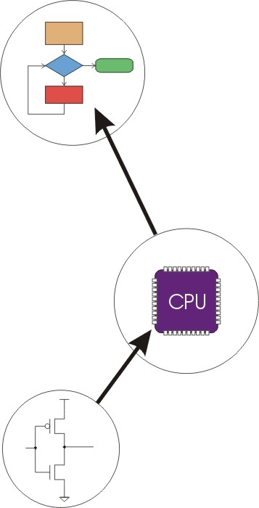
Computer System: Layers of Abstraction
Application Program
Algorithms
Software
Language
Hardware
Instruction Set Architecture
(and I/O Interfaces)
Microarchitecture
Circuits
Devices

Slide 4
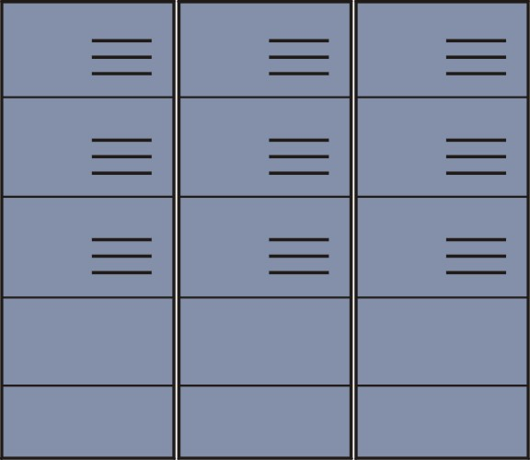
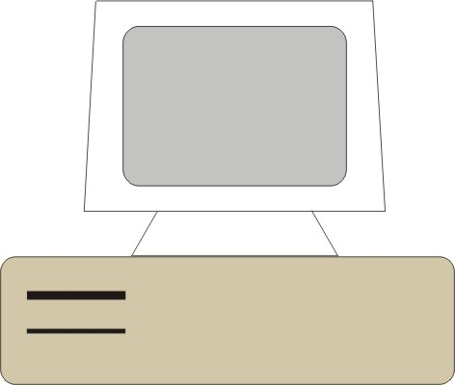
Big Idea #1: Universal Computing Device
All computers, given enough time and memory, are capable of computing exactly the same things.
=
=
Smartphone
Desktop PC
Supercomputer

Slide 5
Turing Machine
Mathematical model of a device that can perform any computation – Alan Turing (1937)
ability to read/write symbols on an infinite “tape”
state transitions, based on current state and symbol
Every computation can be performed by some Turing machine. (Turing’s thesis)
T_{add}
T_{mul}
a,b
a+b
a,b
ab
Turing machine that adds
Turing machine that multiplies
Notes:
Turing predated computers; worked at Bletchley Park during WW2. Home of Colossus (broke German Enigma cipher, was destroyed after WW2 to preserve secrecy!)
More interested in the theory of computing: what was possible

Slide 6
Universal Turing Machine
Turing described a Turing machine that could implement all other Turing machines.
inputs: data, plus a description of computation (Turing machine)
T_{add}, T_{mul}
U
a,b,c
c(a+b)
Universal Turing Machine
U is programmable – so is a computer!
instructions are part of the input data
a computer can emulate a Universal Turing Machine, and vice versa
Therefore, a computer is a universal computing device!

Slide 7
From Theory to Practice
In theory, computer can compute anything
that’s possible to compute
given enough memory and time
In practice, solving problems involves computing under constraints.
time
weather forecast, next frame of animation, ...
cost
$25 cell phone, automotive engine controller, ...
power
battery-operated laptop, handheld video game, ...

Slide 8
Big Idea #2: Transformations Between Layers
How do we solve a problem using a computer? A systematic sequence of transformations between layers of abstraction.
Problem
Software Design:
choose algorithms and data structures
Algorithm
Programming:
use language to express design
Program
Compiling/Interpreting:
convert language to machine instructions
Instr Set
Architecture

Slide 9
Deeper and Deeper…
Instr Set
Architecture
Processor Design:
choose structures to implement ISA
Microarch
Logic/Circuit Design:
gates and low-level circuits to implement components
Circuits
Process Engineering & Fabrication:
develop and manufacture lowest-level components
Devices

Slide 10
Descriptions of Each Level
Problem Statement
stated using "natural language"
may be ambiguous, imprecise
Algorithm
step-by-step procedure, guaranteed to finish
definiteness, effective computability, finiteness
Program
express the algorithm using a computer language
high-level language, low-level language
Instruction Set Architecture (ISA)
specifies the set of instructions the computer can perform
data types, addressing mode

Slide 11
Descriptions of Each Level (cont.)
Microarchitecture
detailed organization of a processor implementation
different implementations of a single ISA
Logic Circuits
combine basic operations to realize microarchitecture
many different ways to implement a single function (e.g., addition)
Devices
properties of materials, manufacturability

Slide 12
Many Choices at Each Level
Solve a system of equations
Gaussian
elimination
Jacobi
iteration
Red-black SOR
Multigrid
FORTRAN
C
C++
Java
Tradeoffs:
cost
performance
power
(etc.)
Sun SPARC
Intel x86
IBM PowerPC
Pentium 4
Core 2 Duo
AMD Athlon X2
Ripple-carry adder
Carry-lookahead adder
Static CMOS
Dynamic CMOS
Nanomechanical
Notes:
Sun and Java are trademarks of Sun Microsystems, Inc. SPARC is a trademark of SPARC International, Inc. Intel and Pentium are trademarks of Intel Corporation. IBM and PowerPC are trademarks of IBM Corporation. AMD and Athlon and trademarks of Advanced Micro Devices, Inc.

Slide 13
What’s Next
Bits and Bytes
How do we represent information using electrical signals?
Digital Logic
How do we build circuits to process information?
Processor and Instruction Set
How do we build a processor out of logic elements?
What operations (instructions) will we implement?
Assembly Language Programming
How do we use processor instructions to implement algorithms?
How do we write modular, reusable code? (subroutines)
I/O, Traps, and Interrupts
How does processor communicate with outside world?

